Slide 1

House Price Prediction in King County
Hypothesis Testing, Multiple Linear Regression, Random Forest, SVM Linear Regression, ANOVA and Time Series
- Vineet Sampat and Pranav Budhkar (Group 159)

Slide 2
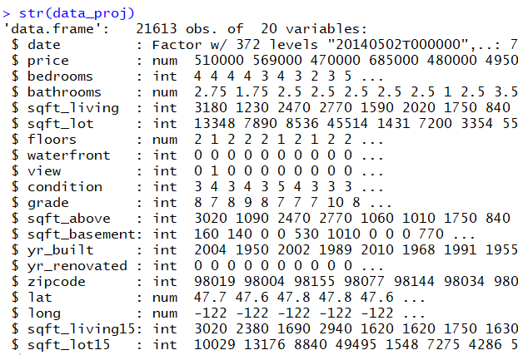
Overview
The dataset is made up of 21614 rows with the dependent variable (y) as price and rest independent variable that influence the house price.
Our objective is to predict price of houses in Kings County for the future and analyze the various factors that influence it.
The variables in our dataset are

Slide 3
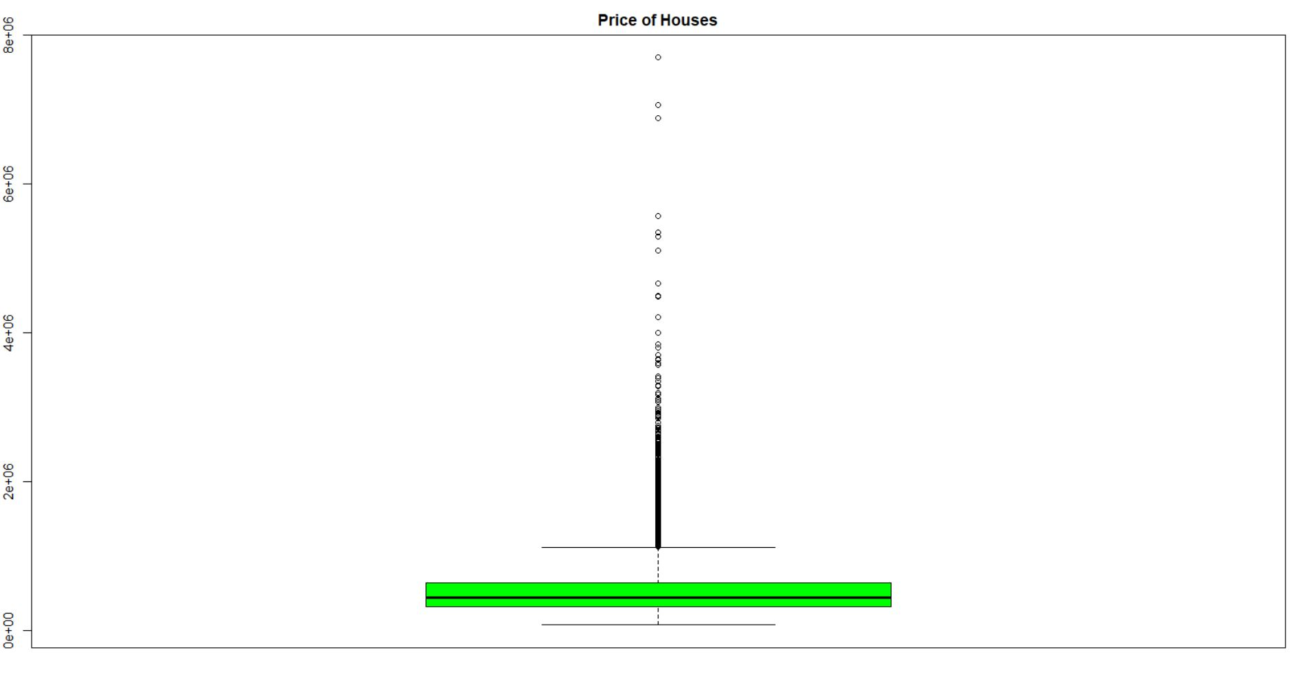
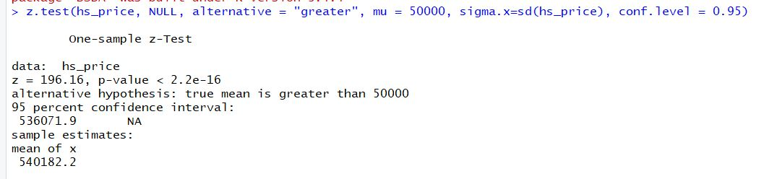
Hypothesis Testing – One Sample Hypothesis Testing
Null Hypothesis(H0) – Average price of house not greater than 50000.
Alternative Hypothesis(Ha) – Average price of house is greater than 50000.
At 95% Confidence interval, we reject Null Hypothesis and accept Alternative Hypothesis.

Slide 4
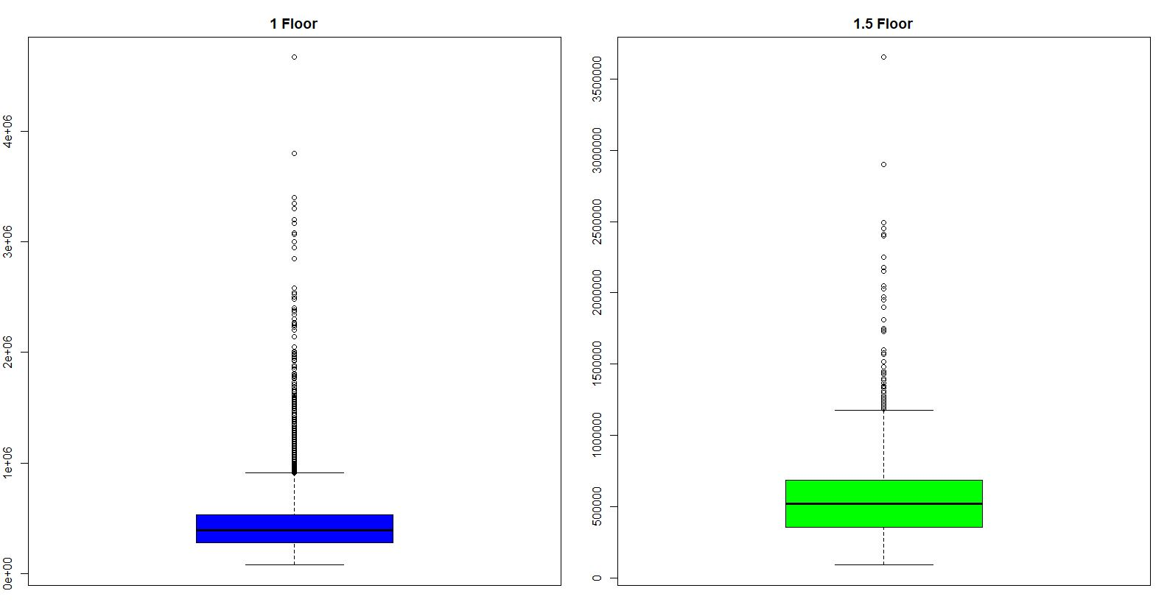
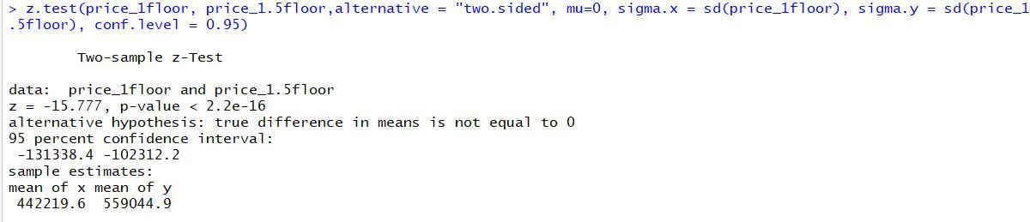
Hypothesis Testing – Two Sample Hypothesis Testing
Null Hypothesis(H0) – Average price of house is same for houses with 1 floor and 1.5 floor.
Alternative Hypothesis(Ha) – We do not believe that average price of houses with different floors is same.
At 95% Confidence interval, we reject Null Hypothesis and accept Alternative Hypothesis.

Slide 5
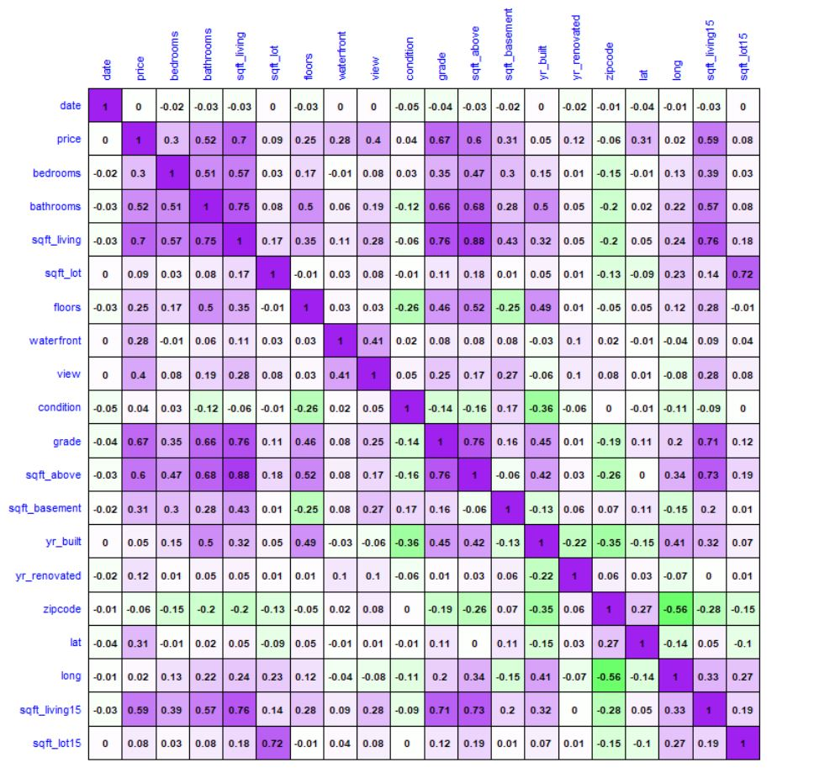
Multiple Linear Regression
We checked the collinearity amongst the independent variable.
The multicollinearity between variables is treated through VIF and applying Transformations.
We have used 10 fold cross validation to build our model.
Residual Analysis of the original model does not have constant variance.
Model evaluation on basis of RMSE.

Slide 6
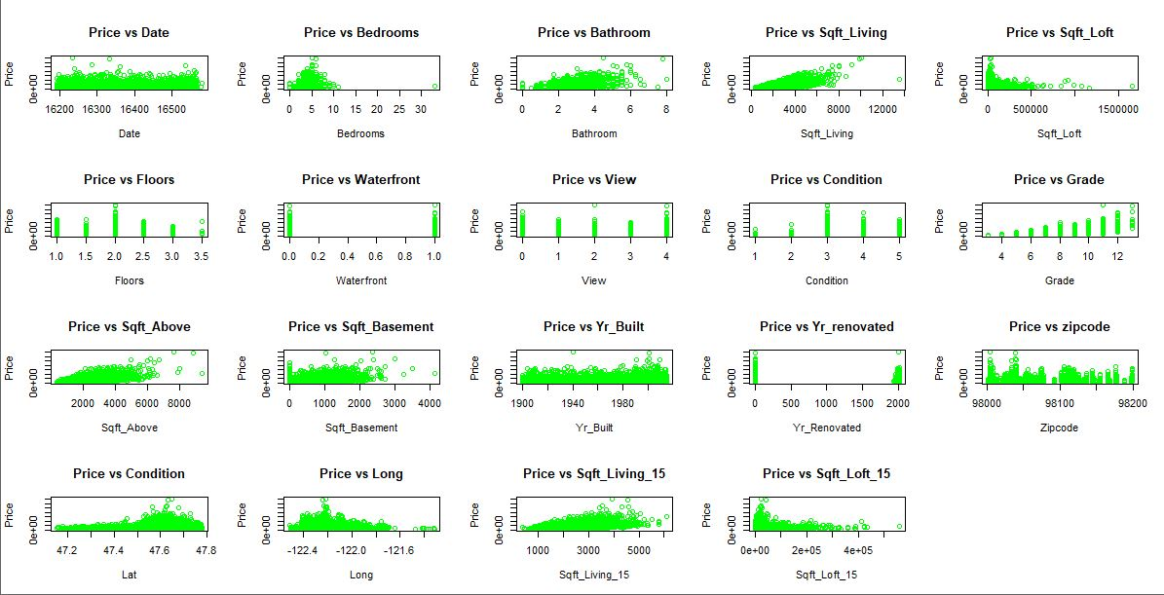
Correlation Plot of y variable “price” with x variables.

Slide 7
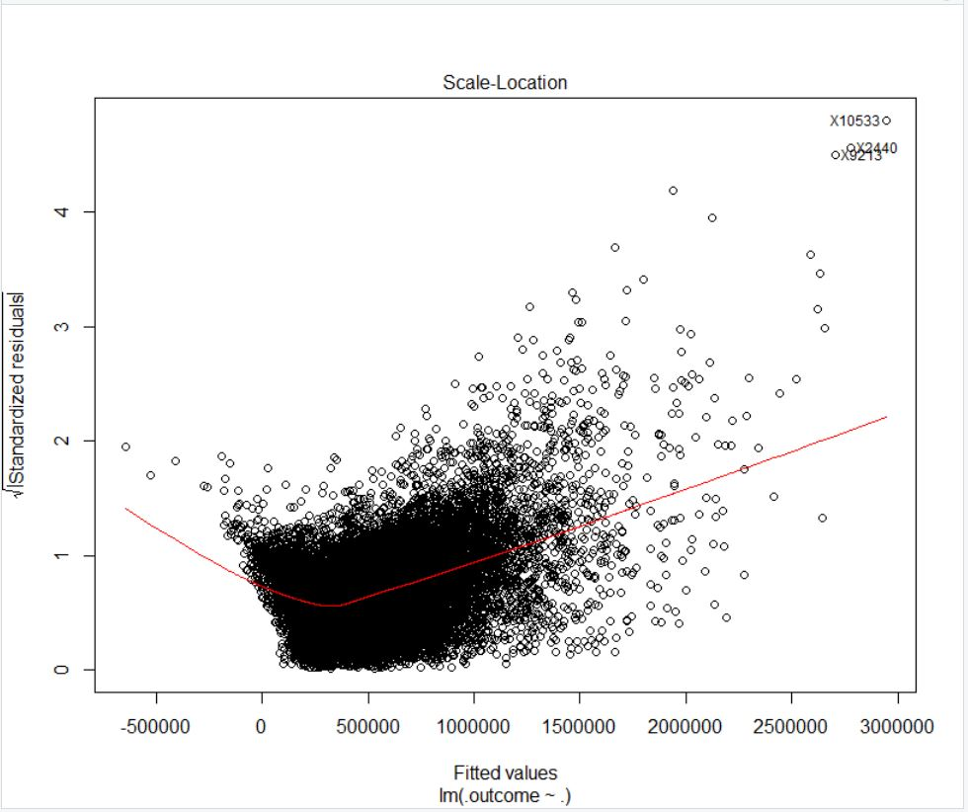
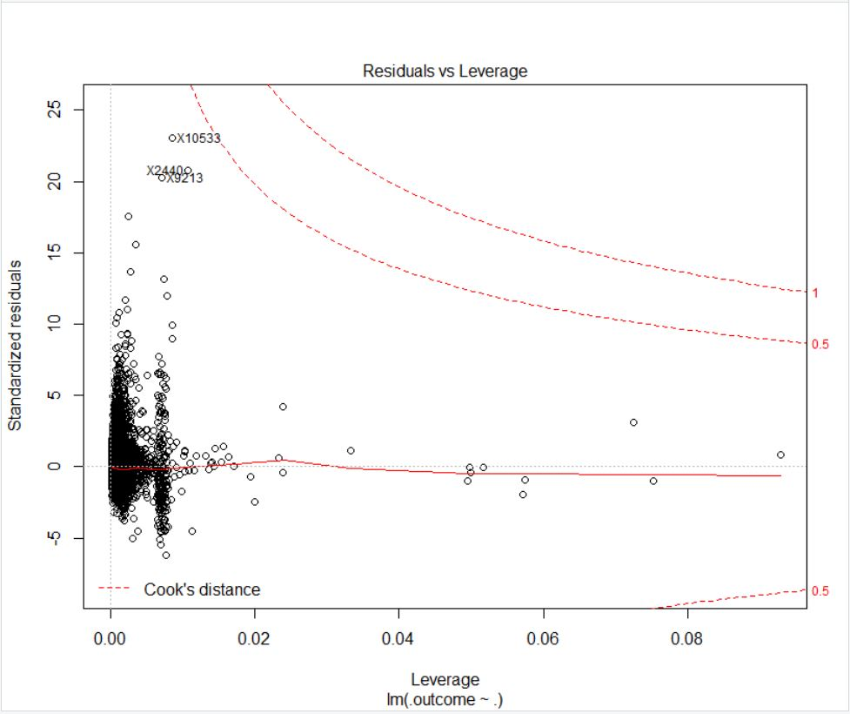
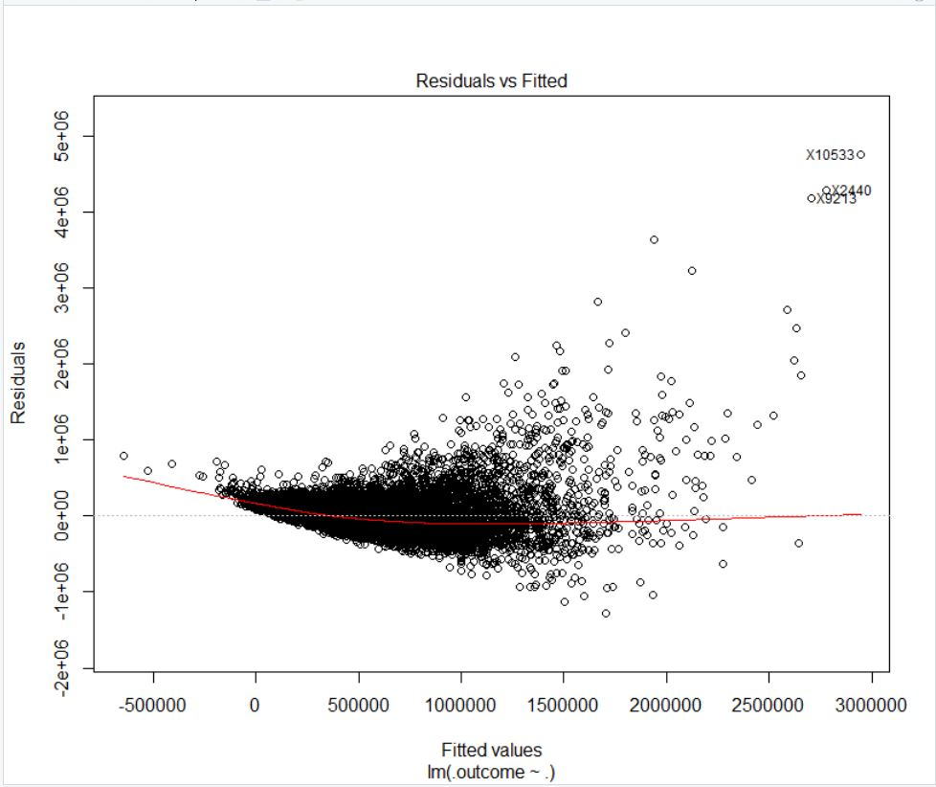
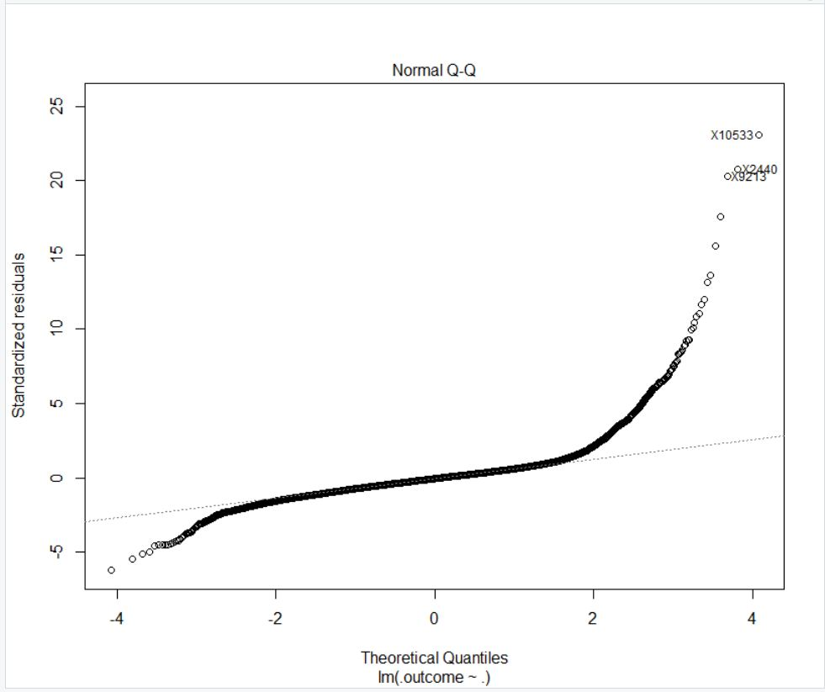
Linear Model Plots – Before Transformation

Slide 8
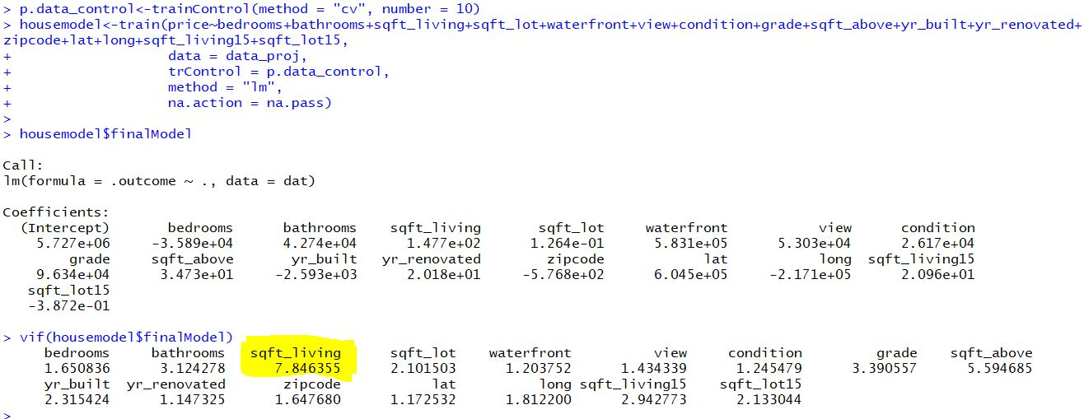
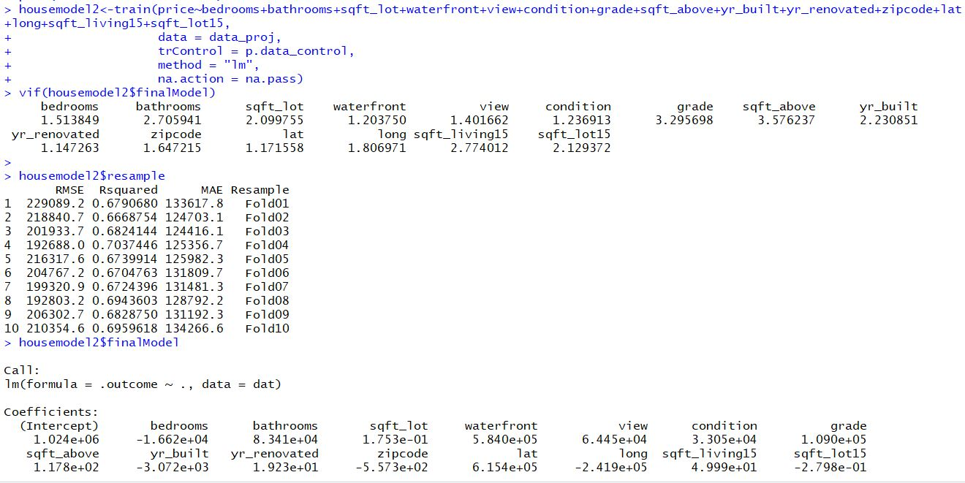
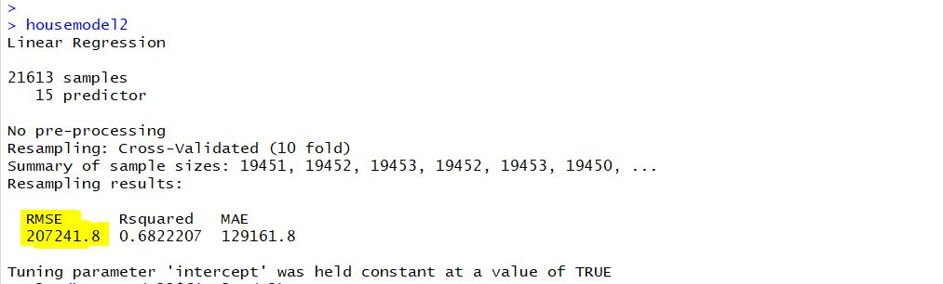
Multiple Linear Regression – Original Model

Slide 9
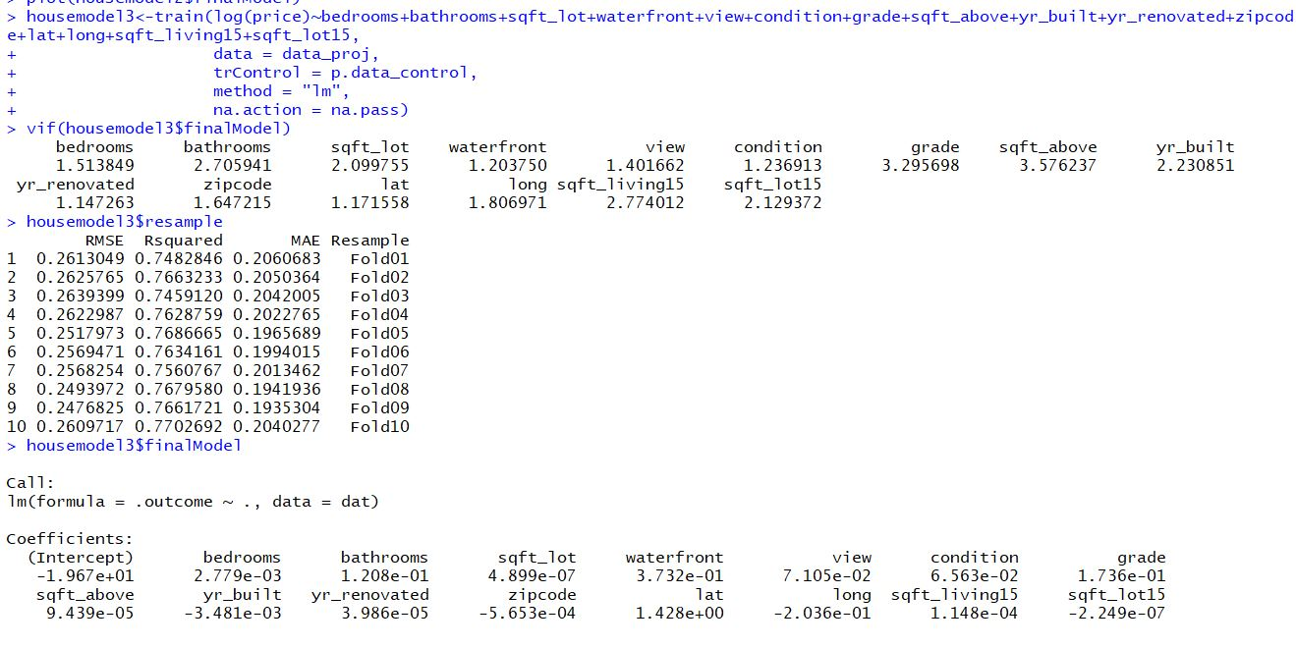
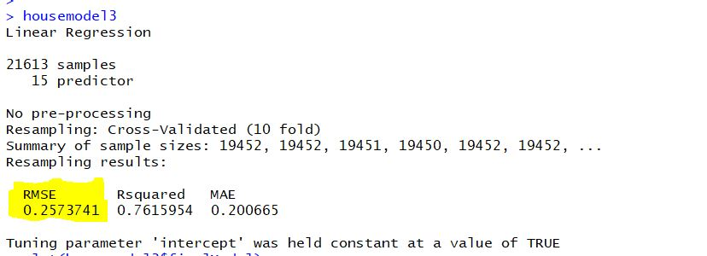
Multiple Linear Regression – Transformation on Model
Applied Transformation on dependent variable y.
As we see the VIF for this model is less than 5.
The new model has RMSE value 0.2573741 and 76% R- square implying that, 76% accuracy in price can be explained by the significant variables.
The variables are mentioned at bottom of the model description chart to the right.

Slide 10
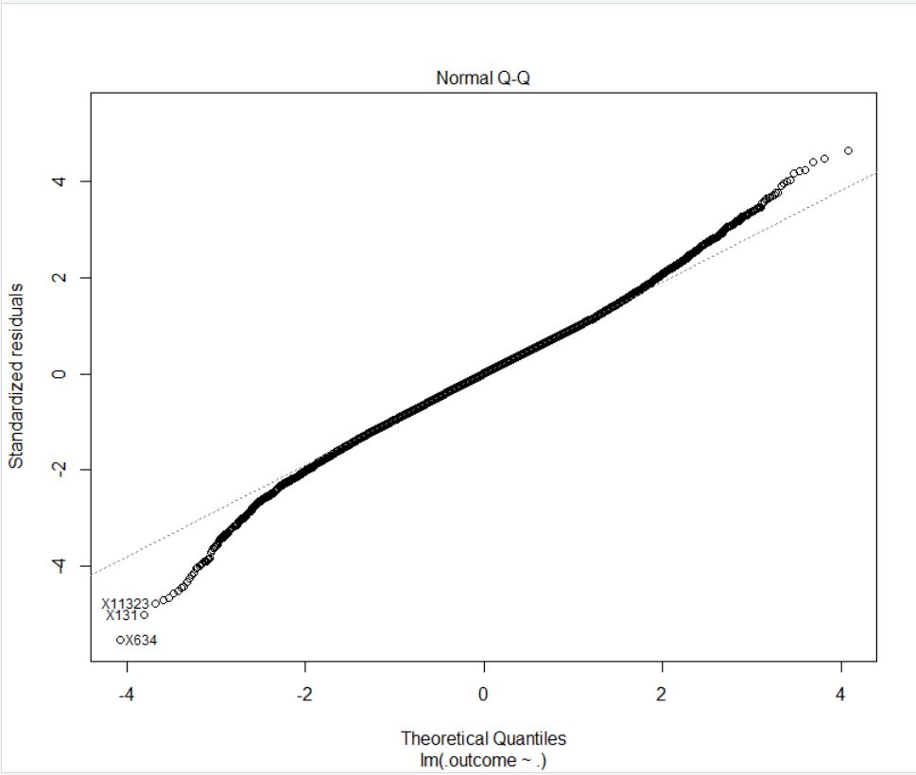
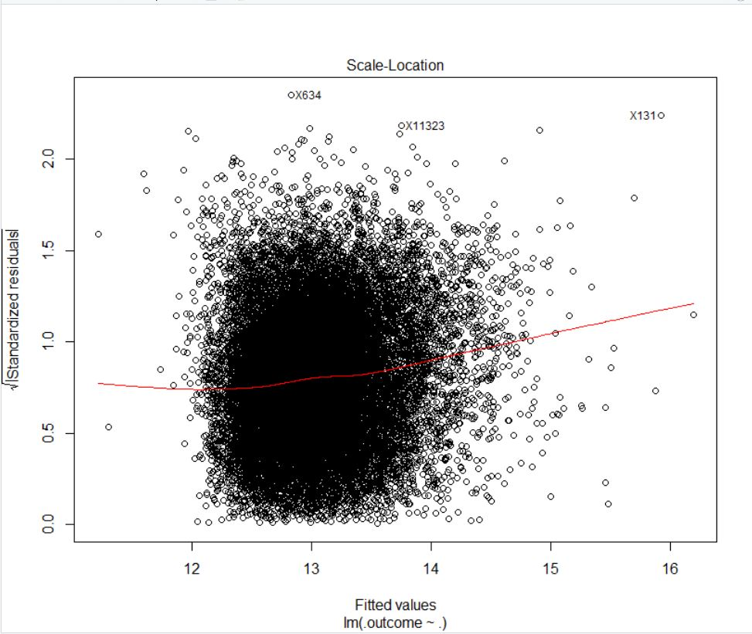
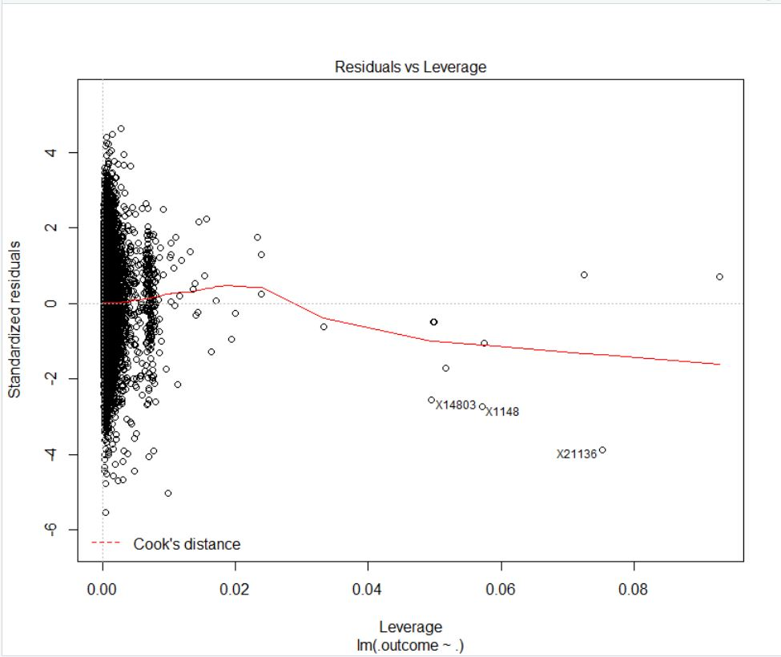
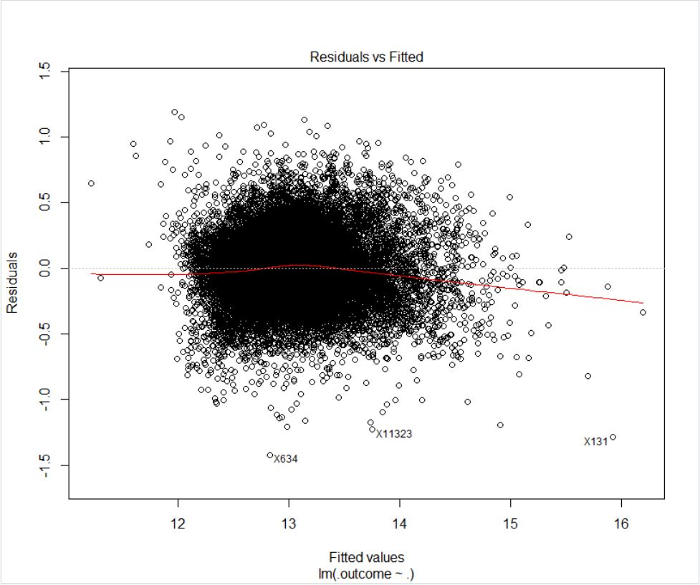
Multiple Linear Model Plots – After Transformation

Slide 11
Multiple Linear Regression – Final Model Post Transformation
The final model generated post transformation is as follows:
Log(price) = -1.967e+01 + (2.779e-03) * bedrooms + (1.208e-01) * bathrooms + (4.899e-07) * sqft_lot + (3.732e-01) * waterfront + (7.105e-02) * view + (6.563e-02) * condition + (1.736e-01) * grade + (9.439e-05) * sqft_above – (3.481e-03) * yr_built + (3.986e-05) * yr_renovated - (5.653e-04) * zipcode + (1.428) * lat – (-2.036e-01) * long + (1.148e-04) * sqft_living15 - (2.249e-07) * sqft_lot15 + e

Slide 12
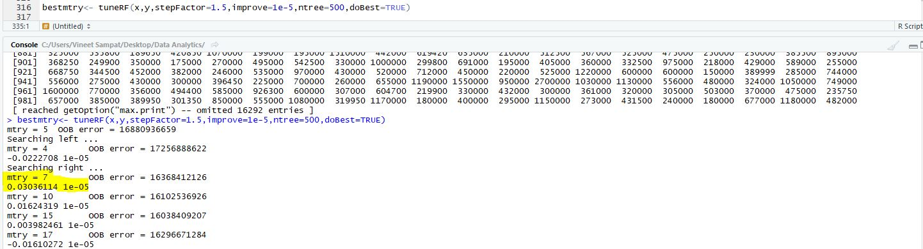
Random Forest Linear Regression Technique
We have used “tuneRF” method to find best “mtry” value.
In our case the best mtry value is ‘7’.
We have used 10 Fold Cross Validation for our Model.
The model build has R-Square value of 89% which implies that this accuracy in price can be explained by significant variables.
Model has RMSE Value of 0.1734794.

Slide 13
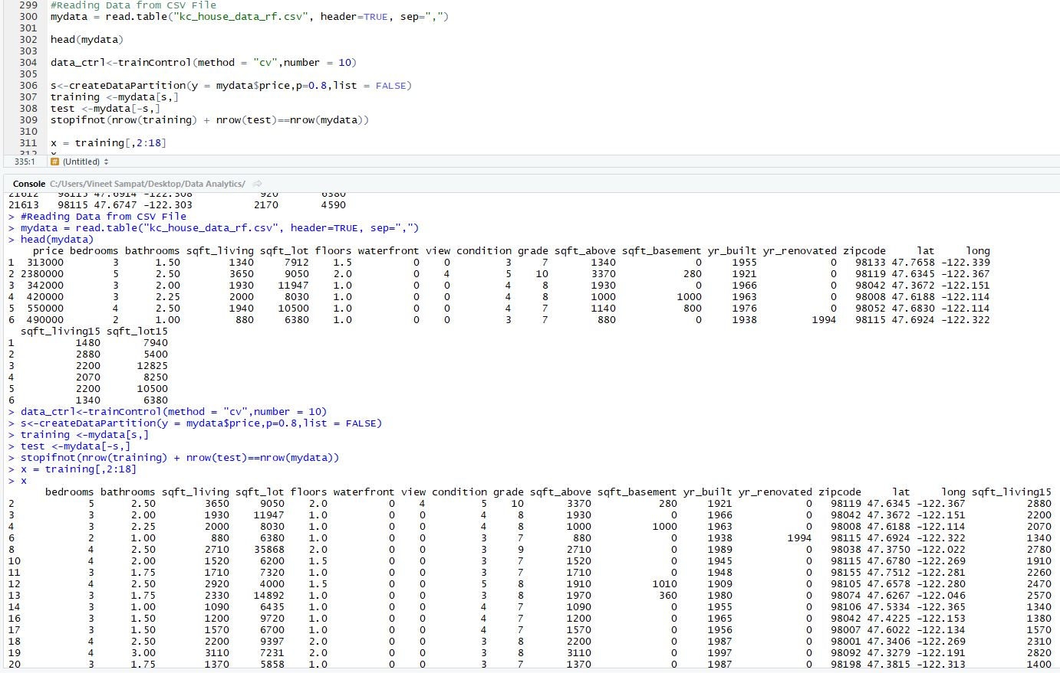
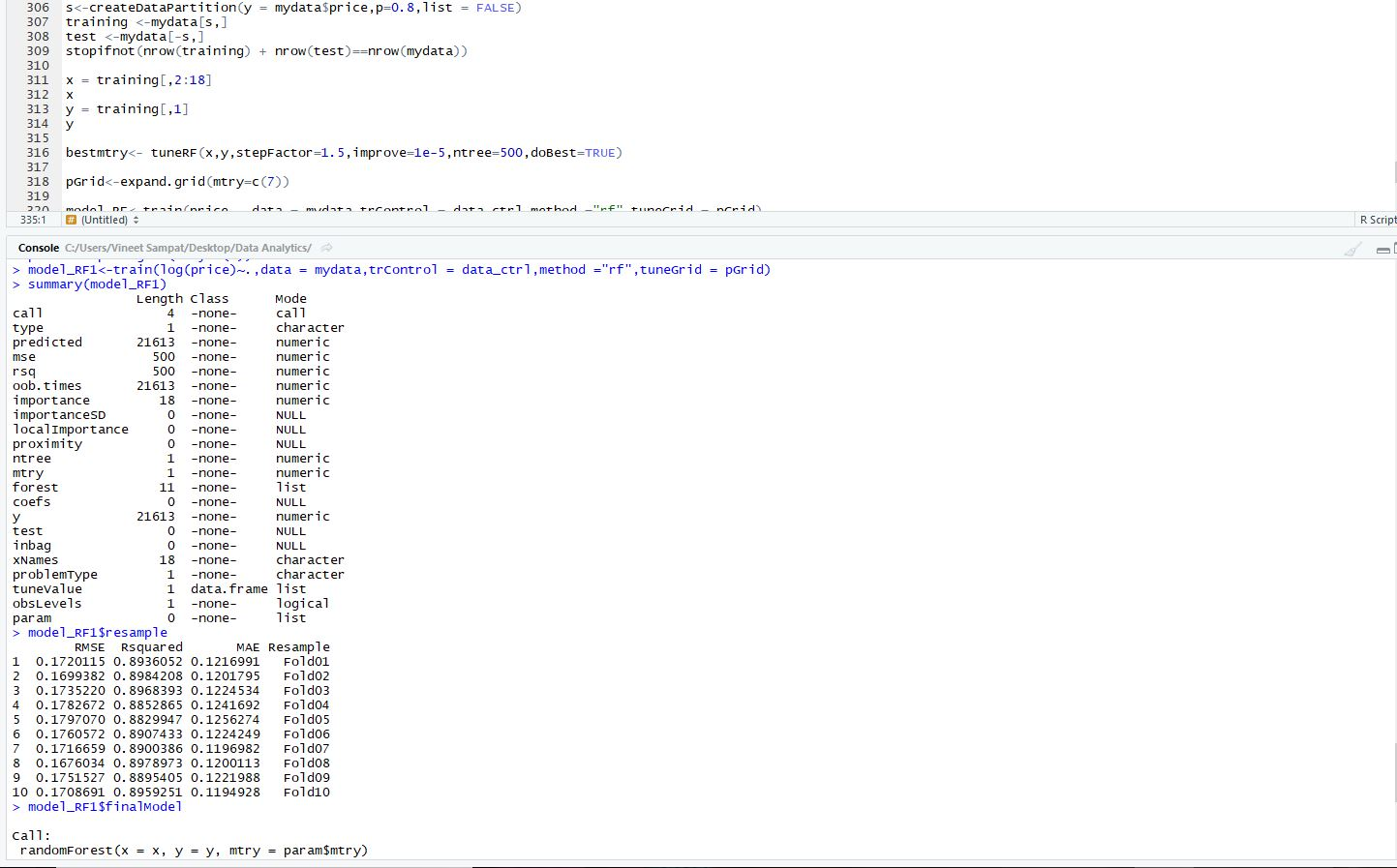
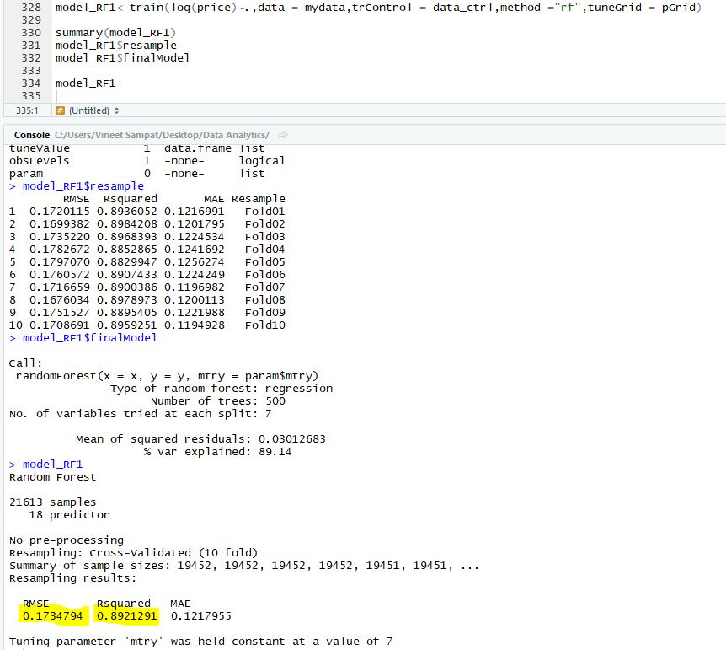
Random Forest – Regression Technique

Slide 14
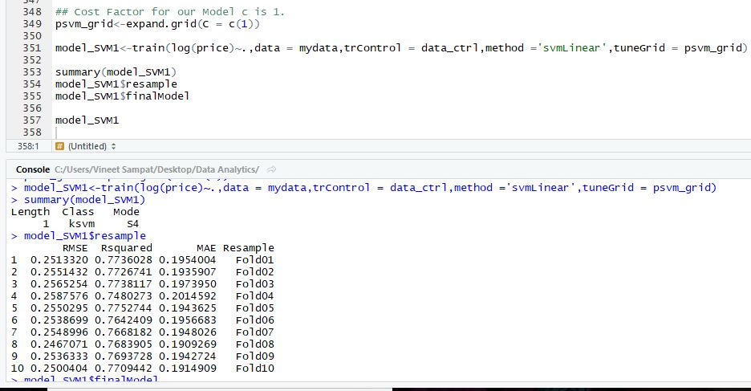
Support Vector Machine Linear Regression Technique
For SVM model, we got the Cost factor as 1.
The model is built using 10 – fold cross validation.
The RMSE value we got is 0.2535938 and the R-square value as 76.83%.

Slide 15
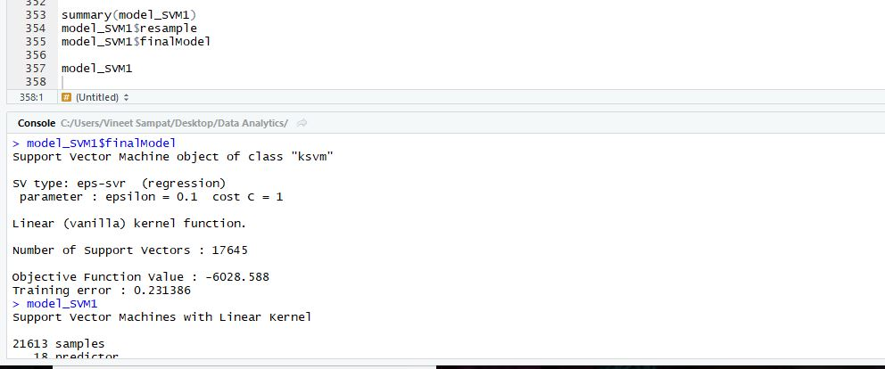
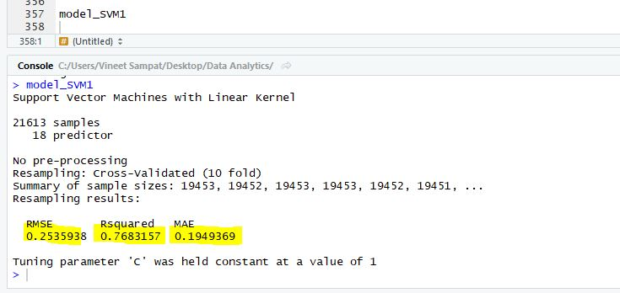
Support Vector Machine Linear Regression

Slide 16
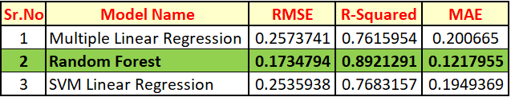
Selecting the Best Model of 3 Regression Techniques
We compare the 3 models on basis of RMSE and MAE value.
In our case, Random Forest has the lowest RMSE and MAE values.
From the table, accuracy for Random Forest is 89.21%. The highest of the 3.
We conclude, Random Forest is best Regression Technique in predicting the house prices in King County.

Slide 17
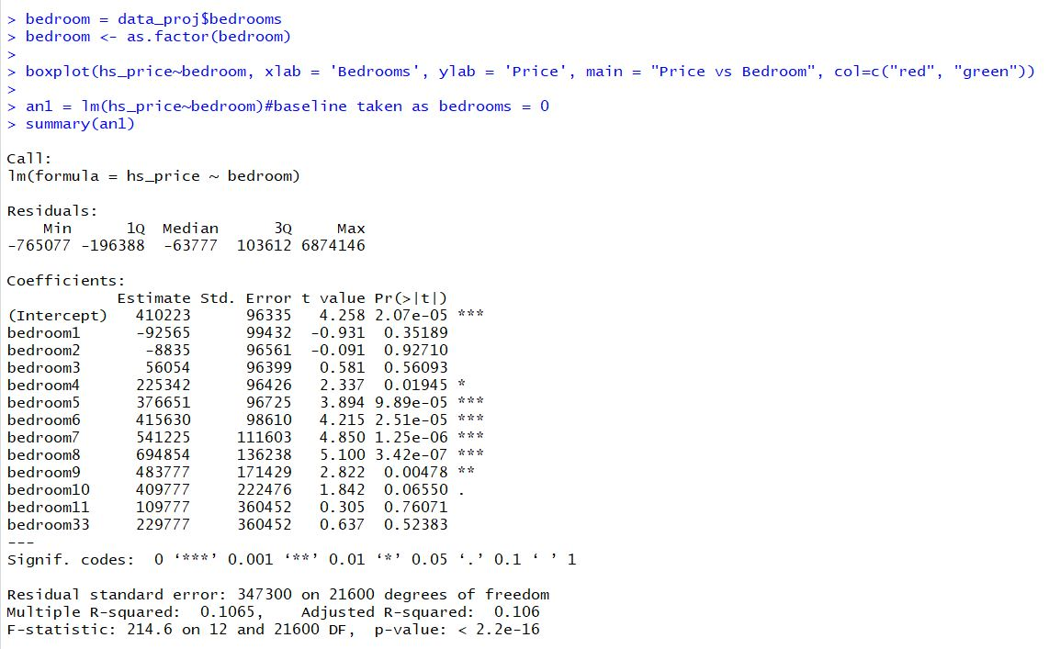
ANOVA – An Application of Linear Regression
We have built ANOVA using liner regression function.
Null Hypothesis(H0) – Group mean price of all houses with different bedrooms are equal.
Alternative Hypothesis(Ha) - Group mean price of all houses with different bedrooms are not equal.
We have considered bedrooms = 0 as base for comparisons with all other bedrooms and have generated the model.
We infer that for bedrooms 5 – 9 the group mean have a significant difference.
From boxplot, bedrooms = 8 has more variance hence, we will relevel the bedroom variable with ref = 8.
Notes:
At 95% Confidence Interval, there is at least 1 group for whom the prices is not same.

Slide 18
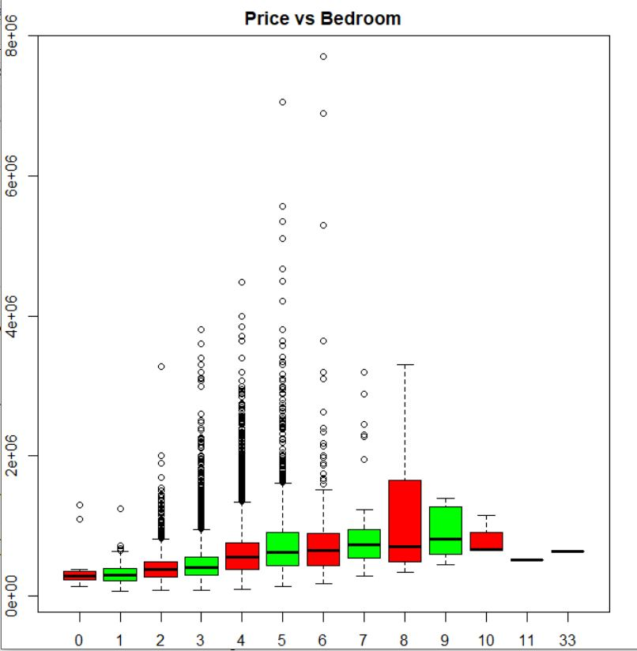
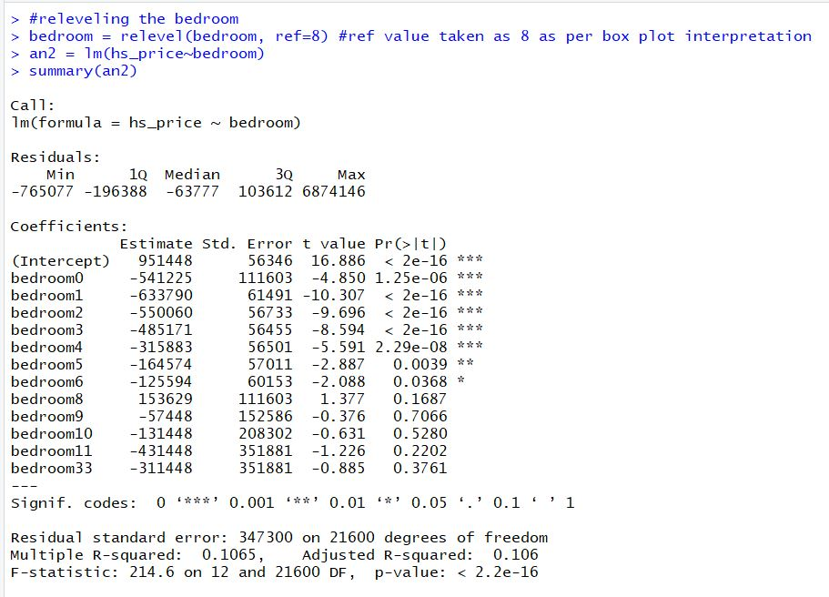
ANOVA – An Application of Linear Regression
On relevel, we see that bedrooms = 0-6 have significant difference than rest of the bedroom prices with p-value < 0.05.
Also, from F – statistic the p-value < 0.05.
Therefore, we reject the Null Hypothesis and accept the Alternate Hypothesis, i.e. The group mean price of houses with different bedrooms is not equal.
Notes:
At 95% Confidence Interval, there is at least 1 group for whom the prices is not same.

Slide 19
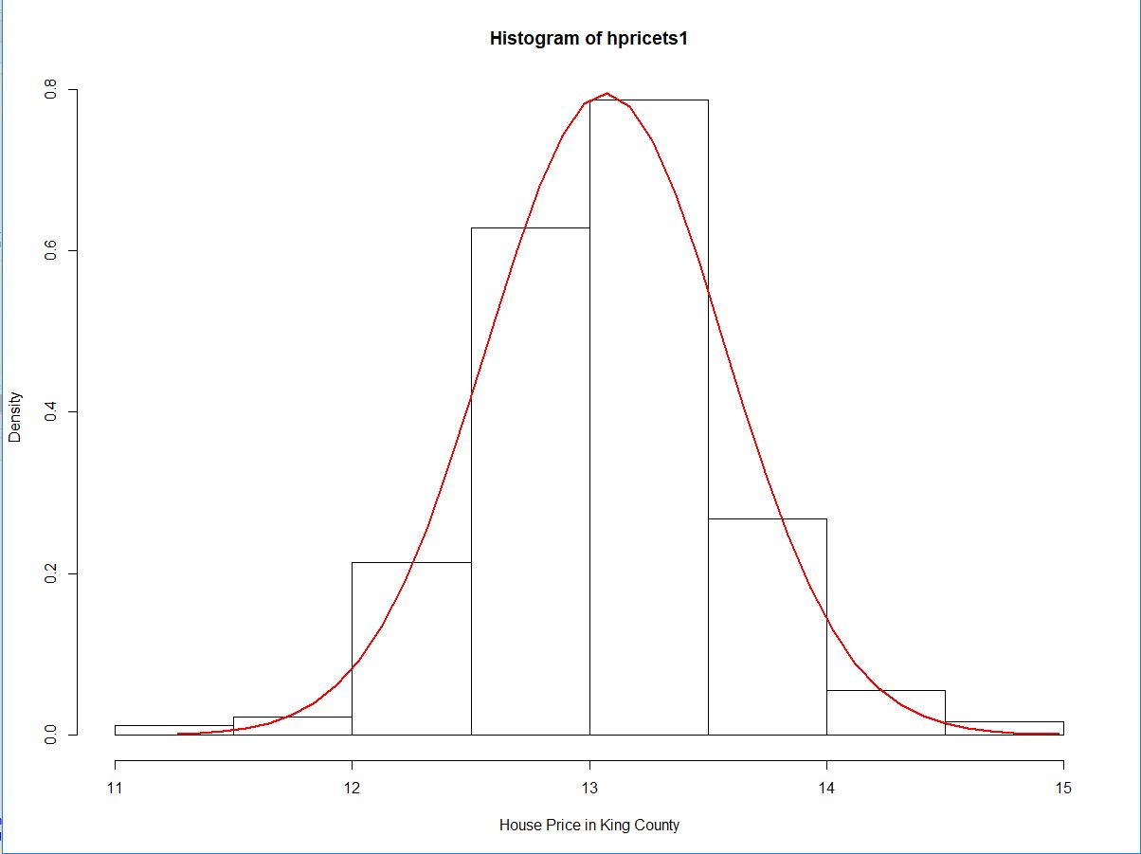
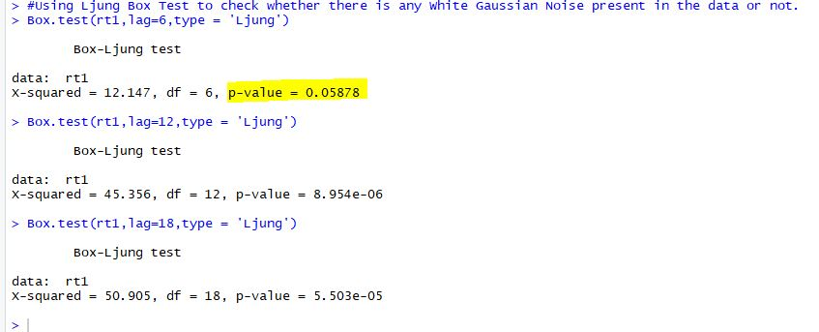
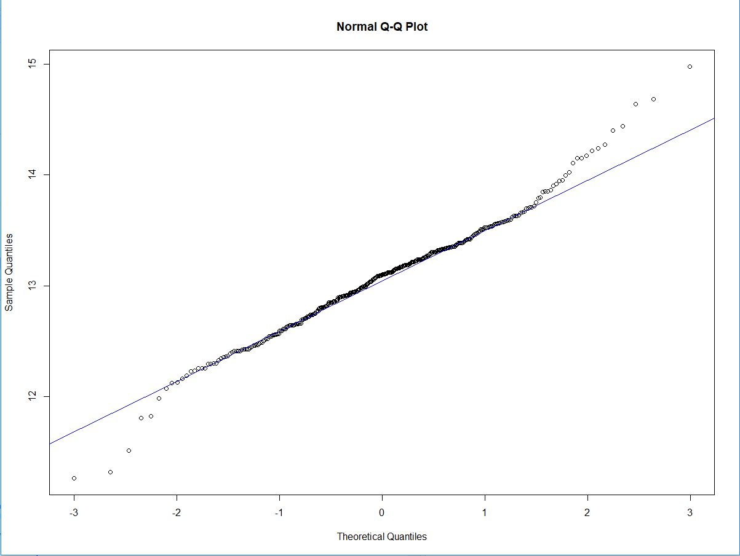
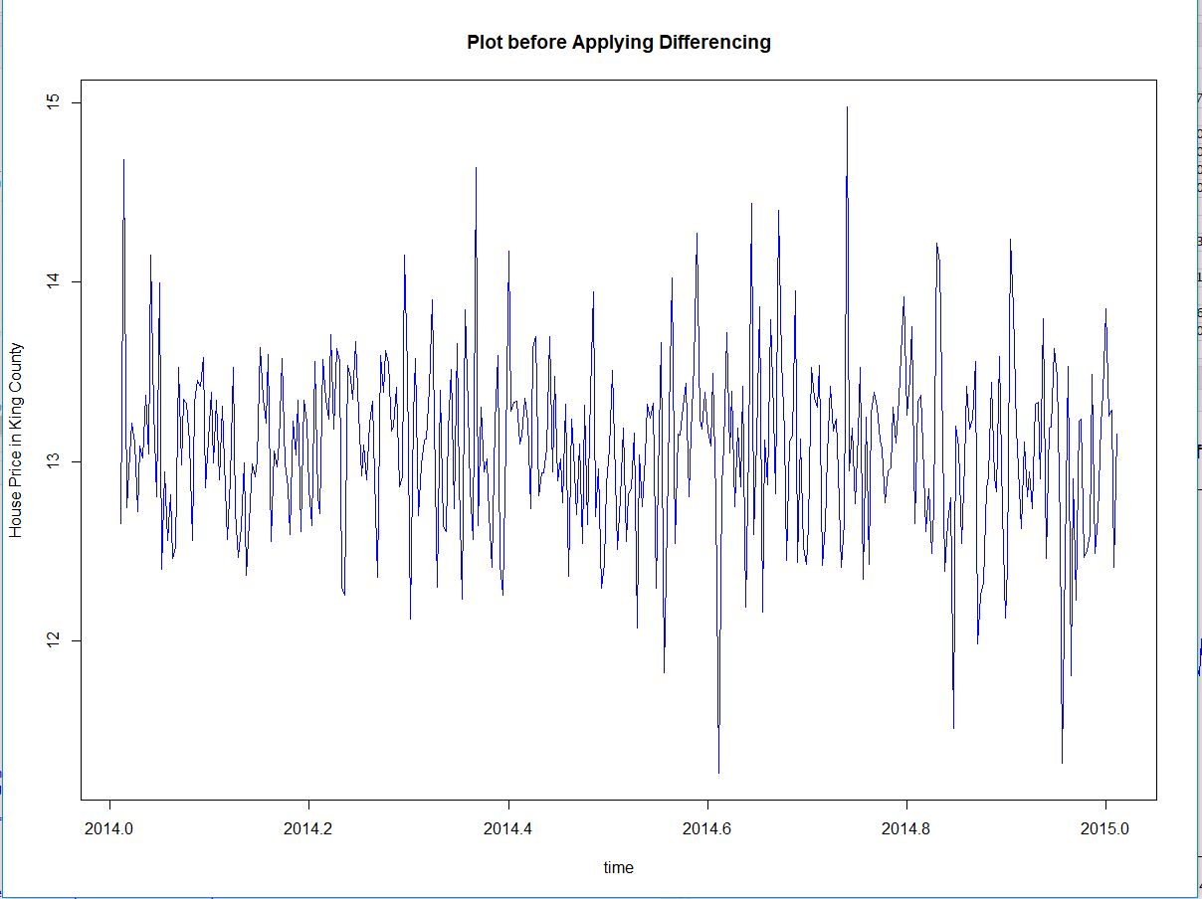
Time Series – Predictions, Evaluations, and Forecasting
We have considered only 2 variables i.e. y = price and x = date.
Initial analysis, we plotted histogram, Ljung-Box Test, Normality Test and Time series (stationary check).
From the time series plot, we see that the data is somewhat stationary.
Thus, we will apply differencing and replot.

Slide 20
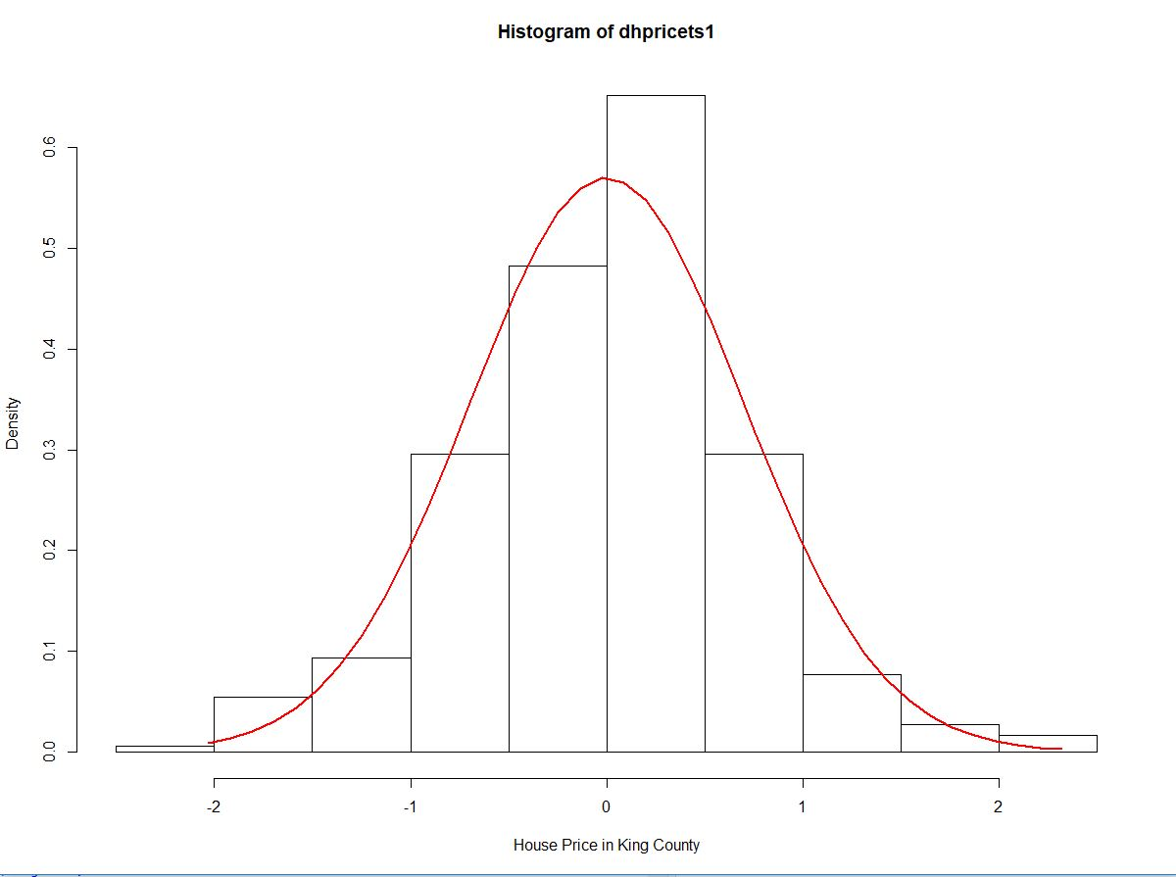
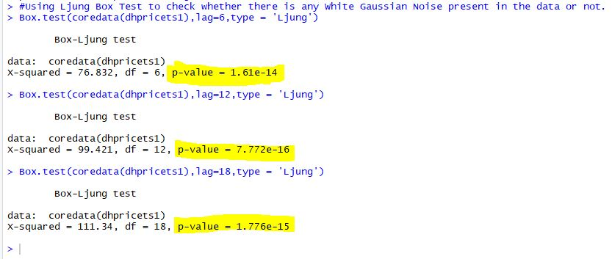
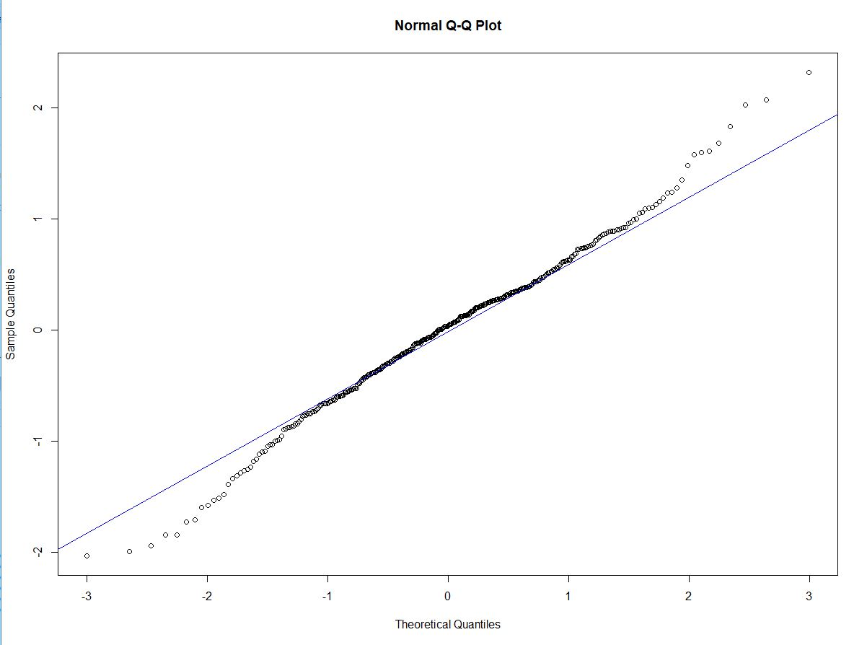
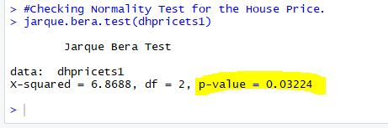
Time Series – Applying Differencing
Histogram follows Normal Density Distribution.
Ljung-Box Test, we have p – value < 0.05 at 95% confidence.
QQ plot shows most of the point on and near the line.
Jarque-Bera Test, we see, it follows normal distribution as p-value < 0.05.

Slide 21
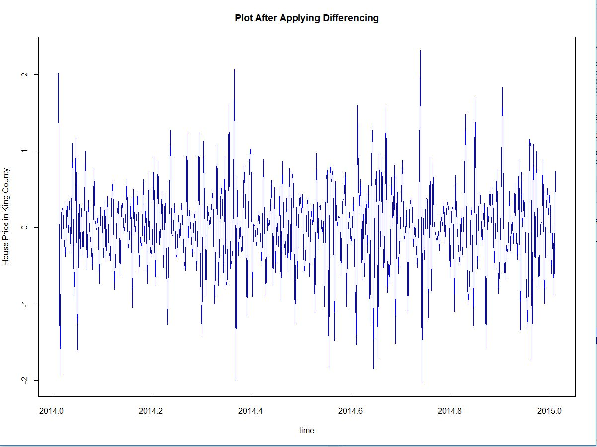
Time Series – Final Time Series Plot with constant mean and variance.

Slide 22
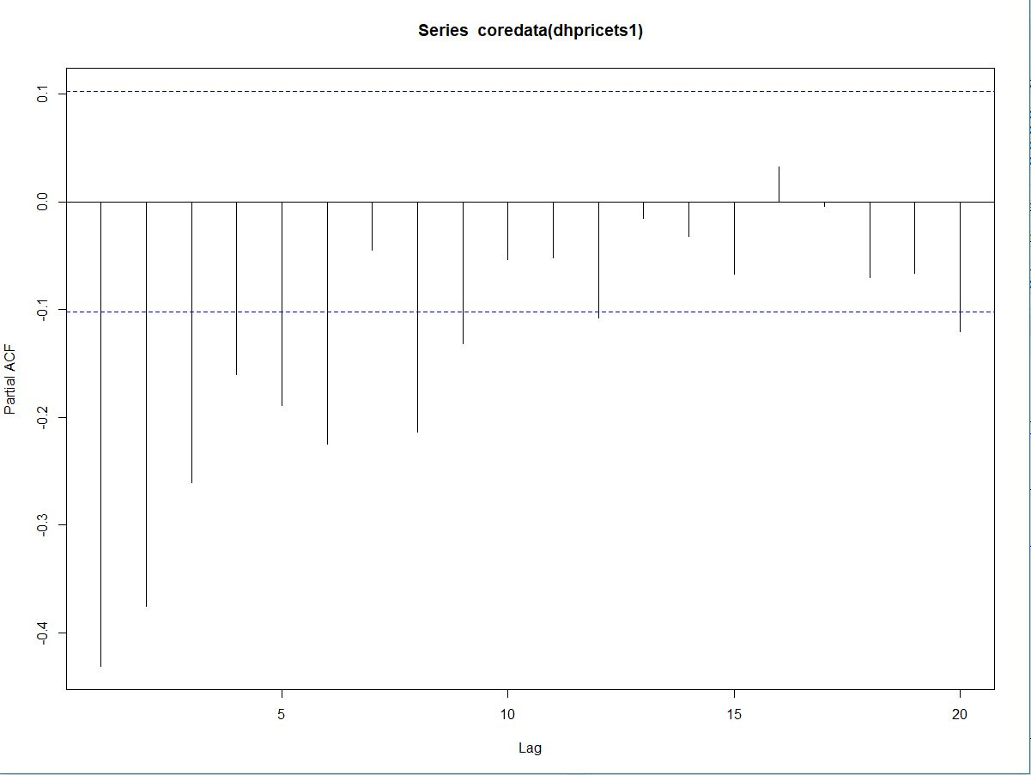
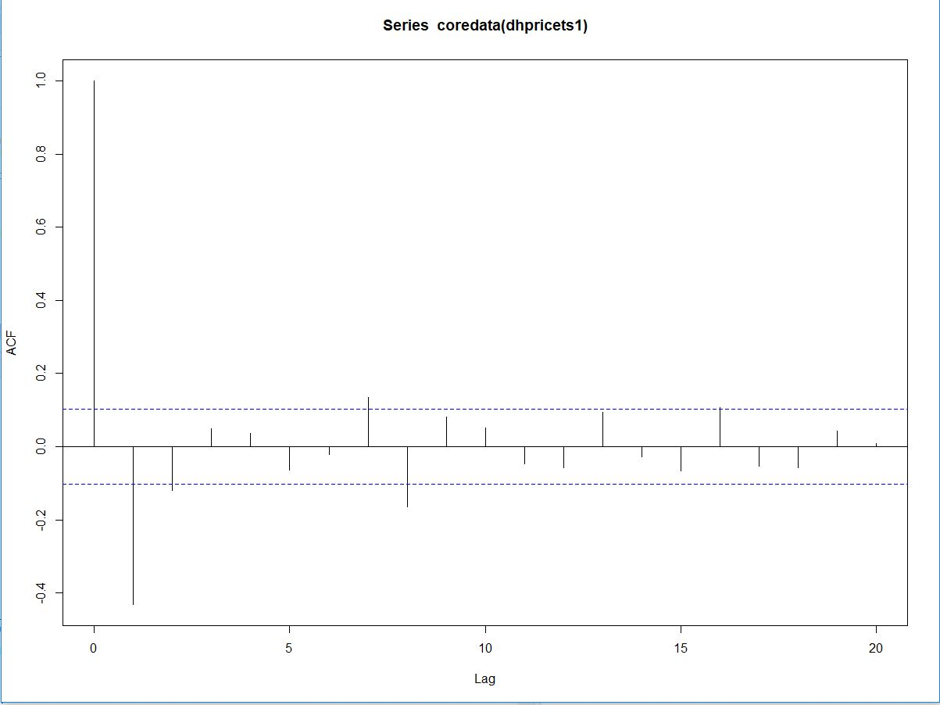
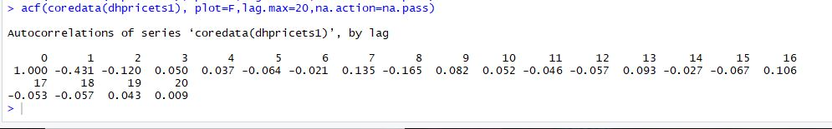
Time Series – PACF and ACF plots
The PACF plot lags off at 1.
Therefore, selecting p value = 1 for AR model.
Similarly, the ACF plot lags off at 1.
Thus, selecting the q value = 1 for MA model.
Notes:
At 95% Confidence Interval, there is at least 1 group for whom the prices is not same.

Slide 23
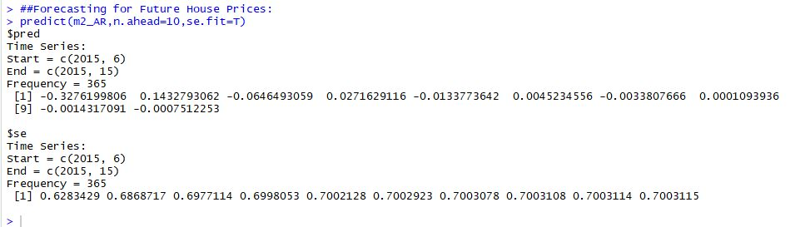
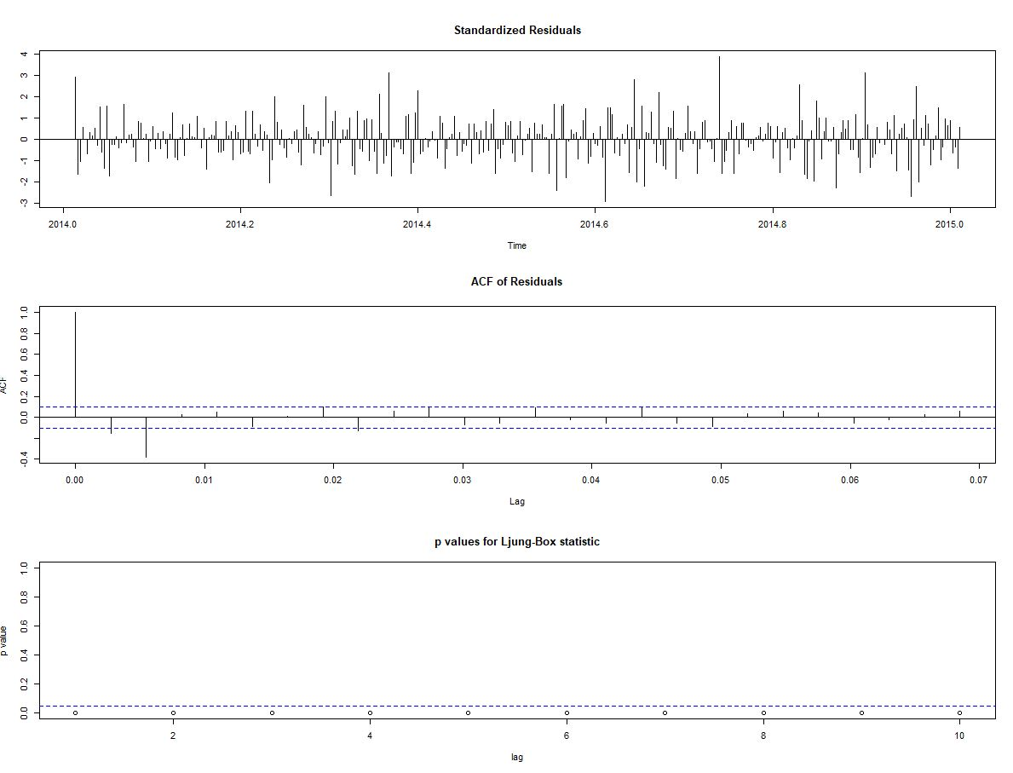
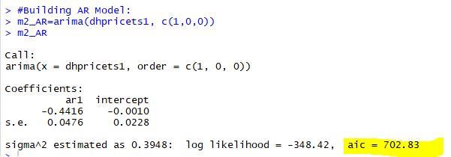
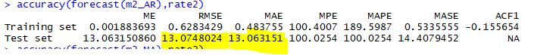
Time Series – AR Model (1,0,0)
The AIC value we got is 702.83.
We used forecast() on test set m2_AR.
RMSE and MAE values used for evaluating the model.
We have predicted future 10 values for prices.

Slide 24
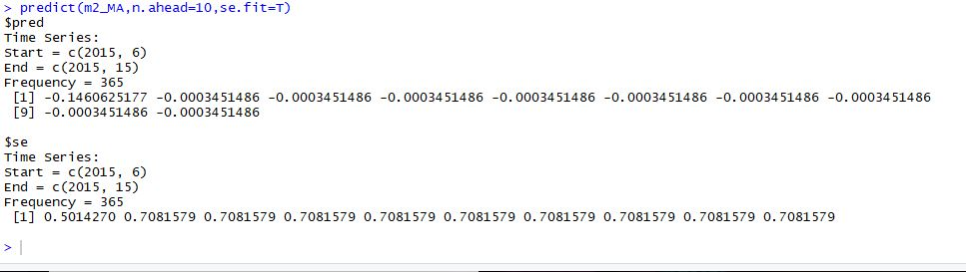
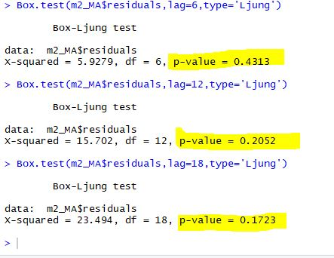
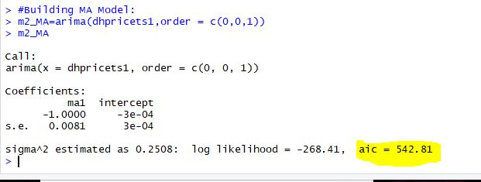
Time Series – MA Model (0,0,1)
The AIC value we got is 542.81.
We used forecast() on test set m2_MA.
RMSE and MAE values used for evaluating the model.
We have predicted future 10 values for prices.
From Ljung – Box test we see that the residuals are white noise independent.

Slide 25

Time Series – MA Model Residual Analysis.

Slide 26



Time Series – ARMA Model (1,0,2)
The AIC value we got is 543.29.
We used forecast() on test set m2_ARMA.
RMSE and MAE values used for evaluating the model.
We have predicted future 10 values for prices.

Slide 27



Time Series – ARIMA Model using auto.arima()
Auto.arima() automatically determines p and q value for the model.
The AIC value we got is 775.95.
We used forecast() on test set m2_ARIMA.
RMSE and MAE values used for evaluating the model.
We have predicted future 10 values for prices.

Slide 28
Time Series – Best Model Selection
On basis AIC value, the accuracy of MA model is best with aic = 542.81.
However, on basis of MAE and RMSE values – MA and ARIMA are best models.
Thus, we can select MA or ARMA model for future predictions of houses in King County area.

Slide 29


